Slide 1

Research Methods & Data collection in Case Writing

Slide 2
Key Differences Between Case Studies and Research Papers
Aspect | Case Study | Research Paper
Purpose | Analyzes a specific issue/decision making. Used for in-depth, Classroom discussion (In-company presentation in some cases) | Answers a research question, test a hypothesis, or explore a theory, adds to existing literature
Focus | Specific, practical application of theory in real-world contexts | Theoretical, broader generalization of results
Methodology | Qualitative (and sometimes mixed) data collection, practical analysis | Quantitative and/or qualitative methods, hypothesis-driven research
Structure | Introduction, background, analysis, solutions, (As per Case Publisher format) | Abstract, introduction, literature review, methodology, results, discussion, recommendations, limitations
Length | Typically shorter, 5-15 pages | Typically longer, 10-20 plus pages
Audience | Industry professionals, students, and managers | Academics, researchers, and scholars
Examples | Case study on a business strategy or organizational change | Research paper on the impact of marketing on consumer behavior

Slide 3
Primary Data and its Sources
Primary data is original, first-hand information that is collected directly from the source. It is tailored specifically to the research at hand. Primary data is often unique to the study sample and provides specific insights into the situation being studied.
Interviews: : Structured or semi-structured interviews with individuals who are directly involved in the case (e.g., managers, employees, stakeholders, customers).
Surveys and Questionnaires: These are used to gather quantitative or qualitative data from a larger sample of people involved in or affected by the case question. May have close ended rating questions or open ended questions.
Observations: Directly observing behavior, processes, or events can yield rich data. This is especially useful in fields like organizational behavior, marketing etc.
Focus Groups: Small groups of participants discuss the case topic, providing rich qualitative data through group interactions.
Experiments: In some cases, researchers may conduct controlled experiments to observe cause-and-effect relationships between variables.

Slide 4
Secondary Data & its Sources
Information that has already been collected, analyzed, and published by others.
Academic Journals and Research Papers:, Published academic studies, articles, and books that provide theoretical frameworks, models, and prior research relevant to the case.
Government Reports and Publications: Statistical data, regulations, policy documents, and other government publications.
Industry Reports and Market Research: Data published by market research firms, industry reports, and company white papers that provide market analysis, trends, or competitive intelligence.
News Articles and Media Reports: News outlets and media sources (recent Indigo crisis) can provide context and current event data related to a case study.
Company Reports (Annual Reports, Financial Statements): Many companies publish reports on their operations, financial performance, and future outlooks, which can be used in case studies to understand company strategies, risks, and performance.
Books and Textbooks: Scholarly books or textbooks that provide an overview of theories, principles, or historical case examples.

Slide 5
Quantitative vs. Qualitative Data Analysis:
Aspect | Quantitative Data Analysis | Qualitative Data Analysis
Focus | Numerical patterns, measurements, relationships | Understanding experiences, meanings, and themes
Nature of Data | Numerical, measurable data (e.g., sales figures, ratings) | Non-numerical, textual or visual data (e.g., interviews, observations)
Methods | Descriptive statistics, regression, correlation analysis etc. | Thematic analysis, content analysis, narrative analysis
Objective | To quantify data and generalize results | To understand underlying reasons, experiences, and meanings
Outcome | Statistical relationships, trends, and patterns | In-depth themes, narratives, and insights
Strengths | Objectivity, generalizability, replicability | Rich, detailed insights, context-rich understanding
Challenges | Limited context, may overlook nuances | Subjectivity, time-consuming, difficult to generalize

Slide 6
Mixed Methods Approach
(Combining Quantitative and Qualitative Methods)
Provides a more comprehensive understanding by combining the strengths of both approaches.
Quantitative data provides measurable, statistical insights (e.g., sales figures, hiring numbers etc.).
Qualitative data provides deeper, contextual understanding and personal perspectives (e.g., interview responses, customer stories).
Using both approaches together can give you a fuller picture of the case and help to validate your findings with both numerical evidence and rich, descriptive context.

Slide 7
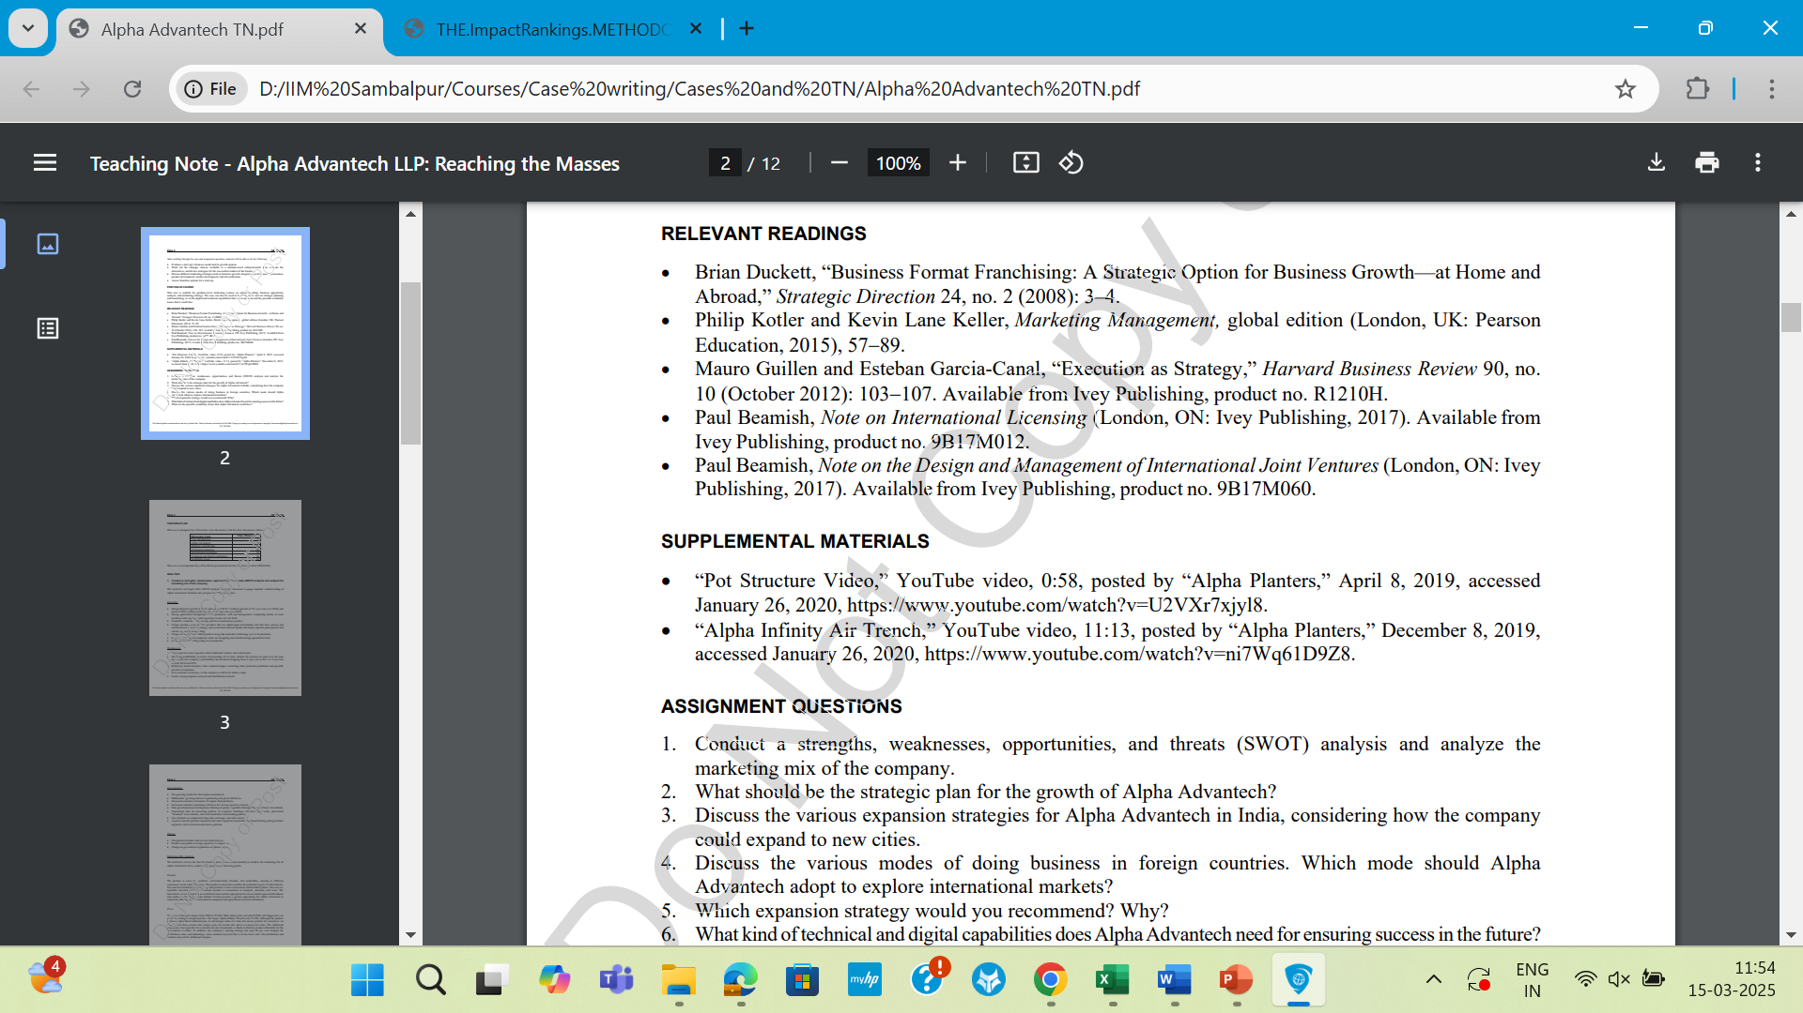
How to cite sources for your case study?

Slide 8
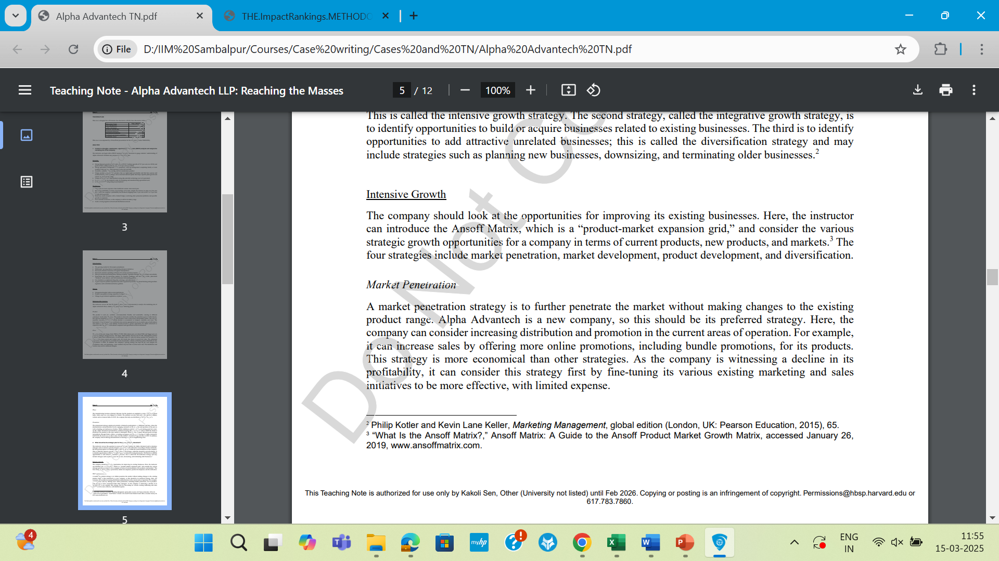
How to cite sources for your case study? Cont’d. (Adding Footnotes)

Slide 9

How to cite sources for your case study? Cont’d.
(How to cite multiple times)

Slide 10
Case sites/ Business resources
Sector specific information
  India Brand Equity Foundation (https://www.ibef.org/)
www.acre.hku.hk/
https://caseshub.emeraldgrouppublishing.com/
www.iveypublishing.ca/
https://nacra.net/case-research-journal/articles-on-cases
www.rsm.nl/cdc
www.thecasecentre.org/
https://hbsp.Harvard.edu/educator
https://mitsloan.mit.edu/teaching-resources-library/case-studies

Slide 11
Academic Journals accepting cases
https://onlinelibrary.wiley.com/journal/19113838
www.worldscientific.com/worldscinet/acrj
https://journals.sagepub.com/home/ajc
www.thecasecentre.org/CaseFocus/
www.emeraldgrouppublishing.com/journal/emcs

Slide 12
Journals of Business Cases
https://scispace.com/journals/journal-of-business-case-studies-1thy2p7k
https://nacra.net/case-research-journal/
Asian Case Research Journal
https://www.hec.ca/en/case_centre/ijcsm/index.html (HEC Montreal)
South Asian Journal of Business and Management Cases (BIMTECH)
International Journal of Teaching and Case Studies

Slide 13
IIUM Journal of Case Studies in Management (Affiliated with the International Islamic University Malaysia)
Journal of Business Case Studies (JBCS)
Boston University “Business Case Studies: Journals with Cases
McMaster University “Case Studies in Journals” guide
International Journal of HRM Cases and Research (IJHMCR)
Human Resource Management International Digest (HRMID, Emerald)
Journal of Business Cases and Applications (JBCA, AABRI)

Slide 14

Others…
Darden Publishing
Sage Business Cases
Vikalpa
HEC Montreal Case Centre
IBS Case Development Centre
IE Publishing
INSEAD Publishing
SHRM Cases
Thunderbird Case Studies

Slide 15

Case Writing Competitions
AIMA – Indian Case Research Centre Case writing competition
American University Cairo Emerald case competition
Asia Case Writing competition
AABS Emerald Case Competition
CEEMAN Case writing competition
EFMD Case writing competition
John Molson Case writing competition
LatAm Case writing competition
TCJ Compact Case competition
The Case for women

Slide 16
Thank you !
All the best for your first Case study ☺
kakolis@iimsambalpur.ac.in
+91 99717 97032

